Slide 1


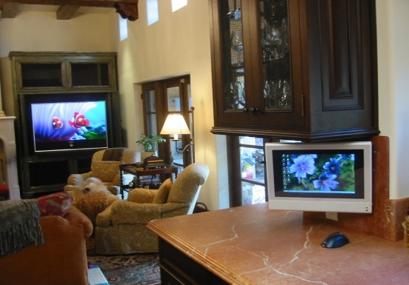

SERENDIB APARTMENTS
LOGO
_____________
_______
LIVE LIFE WITH STYLE
Home
About Us
Image Gallery
Apartments
Account
Contact Us
Why We Are…? Our Facilities
--------------------------------------- ----------------------------------------
--------------------------------------- ----------------------------------------
--------------------------------------- ----------------------------------------
--------------------------------------- ----------------------------------------
--------------------------------------- ----------------------------------------
--------------------------------------- ----------------------------------------
--------------------------------------- ----------------------------------------
--------------------------------------- ----------------------------------------
--------------------------------------- ----------------------------------------
--------------------------------------- ----------------------------------------

Slide 2
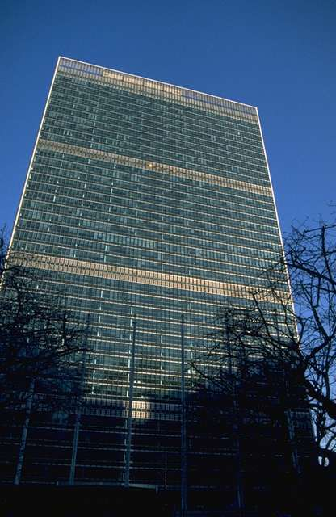
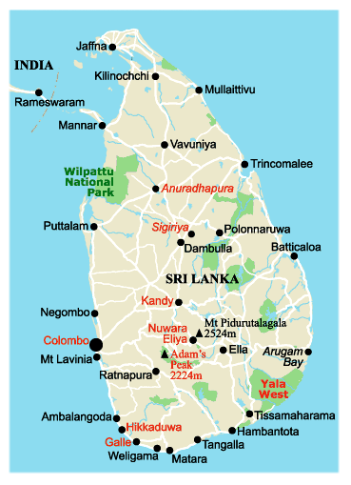
SERENDIB APARTMENTS
LOGO
_____________
_______
LIVE LIFE WITH STYLE
Home
About Us
Image Gallery
Apartments
Account
Contact Us
Location
Facilities
This is how you can go to Serendib
Apartments.
Go to Kolpetty Junction.
Just walk few feets on Gall Road towards Galleface.
Turn into St. Michael’s Road.
Walk few feets.
You will see it on your Right hand side.

Slide 3
SERENDIB APARTMENTS
LOGO
_____________
_______
LIVE LIFE WITH STYLE
Home
About Us
Image Gallery
Apartments
Account
Contact Us
Location
Facilities
Facility 1
Description
Facility 2
Description
Facility 3
Description
---------------------------------------------------------------------------------------------------------------------------------------------------------------------------------------------------------------------------------------------------------------------------------------------------------------------------------------------------------------------------------------------------------------------------------------------------------------------------------------------------------------------------------------------------------------------------------------------------------------------------------------------------------------------------------------------------------------

Slide 4
SERENDIB APARTMENTS
LOGO
_____________
_______
LIVE LIFE WITH STYLE
Home
About Us
Image Gallery
Apartments
Account
Contact Us
Luxury
Semi Luxury
Ordinary
Living Rooms
Bed Rooms
Pantry
Bathrooms , Dining Rooms , Balcony…

Slide 5
SERENDIB APARTMENTS
LOGO
_____________
_______
LIVE LIFE WITH STYLE
Home
About Us
Image Gallery
Apartments
Account
Contact Us
Luxury
Apartment 1 - $$$$$$$$ Rs. (Unavailable)
Apartment 2 - $$$$$$$$ Rs. (Unavailable)
Apartment 3 - $$$$$$$$ Rs. (Unavailable)
…
Semi-Luxury
Apartment 1 - $$$$$$$$ Rs. (Unavailable)
Apartment 2 - $$$$$$$$ Rs. (Unavailable)
Apartment 3 - $$$$$$$$ Rs. (Available)
…
Ordinary
Apartment 1 - $$$$$$$$ Rs. (Unavailable)
Apartment 2 - $$$$$$$$ Rs. (Available)
Apartment 3 - $$$$$$$$ Rs. (Available)
…
Start Date :
End Date :
Calendar
Check

Slide 6
SERENDIB APARTMENTS
LOGO
_____________
_______
LIVE LIFE WITH STYLE
Home
About Us
Image Gallery
Apartments
Account
Contact Us
Available Apartments
Luxury
Apartment 5 - $$$$$$$$ Rs.
Apartment 7 - $$$$$$$$ Rs.
Apartment 10 - $$$$$$$$ Rs.
…
Semi-Luxury
Apartment 3 - $$$$$$$$ Rs.
Apartment 6 - $$$$$$$$ Rs.
Apartment 7 - $$$$$$$$ Rs.
…
Ordinary
Apartment 2 - $$$$$$$$ Rs.
Apartment 3 - $$$$$$$$ Rs.
Apartment 9 - $$$$$$$$ Rs.
…
Start Date :
End Date :
Calendar
Check

Slide 7
SERENDIB APARTMENTS
LOGO
_____________
_______
LIVE LIFE WITH STYLE
Home
About Us
Image Gallery
Apartments
Account
Contact Us
How to Create an Account
Sign Up
Sign In

Slide 8
SERENDIB APARTMENTS
LOGO
_____________
_______
LIVE LIFE WITH STYLE
Home
About Us
Image Gallery
Apartments
Account
Contact Us
How to Create an Account
Sign Up
Sign In
User Name :
Password :
Login
Cancel

Slide 9
SERENDIB APARTMENTS
LOGO
_____________
_______
LIVE LIFE WITH STYLE
Home
About Us
Image Gallery
Apartments
Account
Contact Us
How to Create an Account
Sign Up
Sign In
Name :
Address :
Bla Bla Bla…
Submit
Reset
Cancel

Slide 10
SERENDIB APARTMENTS
LOGO
_____________
_______
LIVE LIFE WITH STYLE
Home
About Us
Image Gallery
Apartments
Account
Contact Us
Name :
Address :
Bla Bla Bla ….
Edit Profile
Log Out

Slide 11
SERENDIB APARTMENTS
LOGO
_____________
_______
LIVE LIFE WITH STYLE
Home
About Us
Image Gallery
Apartments
Account
Contact Us
Edit Profile
Log Out
Name : nffndfbnffbnfn
Address : fnfnvfnvfnvj New Address :
Bla Bla Bla… New Bla Bla Bla… :
Submit
Reset
Cancel

Slide 12
SERENDIB APARTMENTS
LOGO
_____________
_______
LIVE LIFE WITH STYLE
Home
About Us
Image Gallery
Apartments
Account
Contact Us
Address :
Telephone :
Bla Bla Bla :
Manager Customer Affair Manager
Name : Name :
Address : Address :
Telephone : Telepone :
Bla Bla Bla : Bla Bla Bla :

Slide 13
SERENDIB APARTMENTS
LOGO
_____________
_______
LIVE LIFE WITH STYLE
Home
About Us
Image Gallery
Apartments
Account
Contact Us
Payment

